Slide 1
art storyboard that

Slide 2
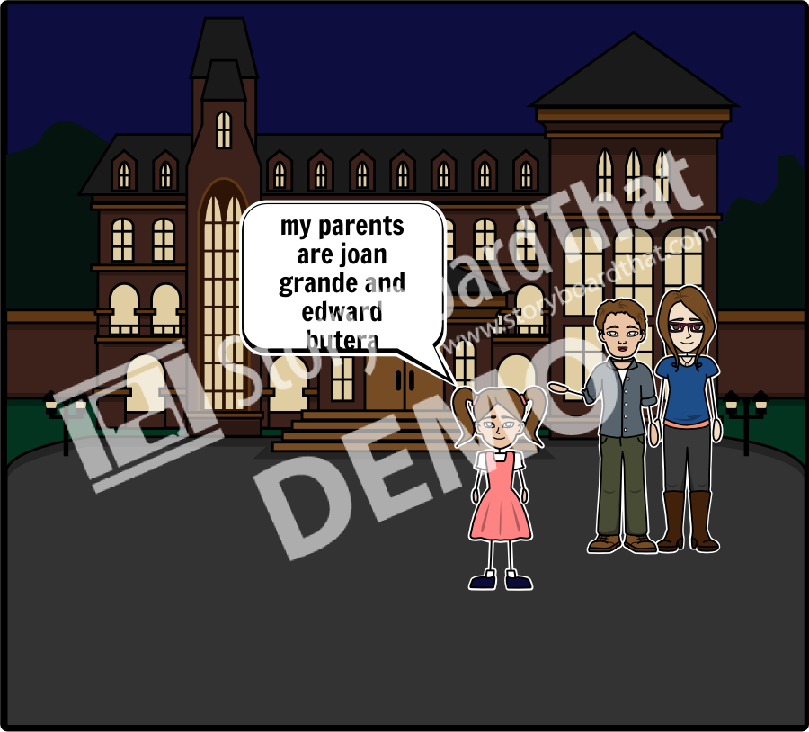
Add Title Here
who were you parents?

Slide 3
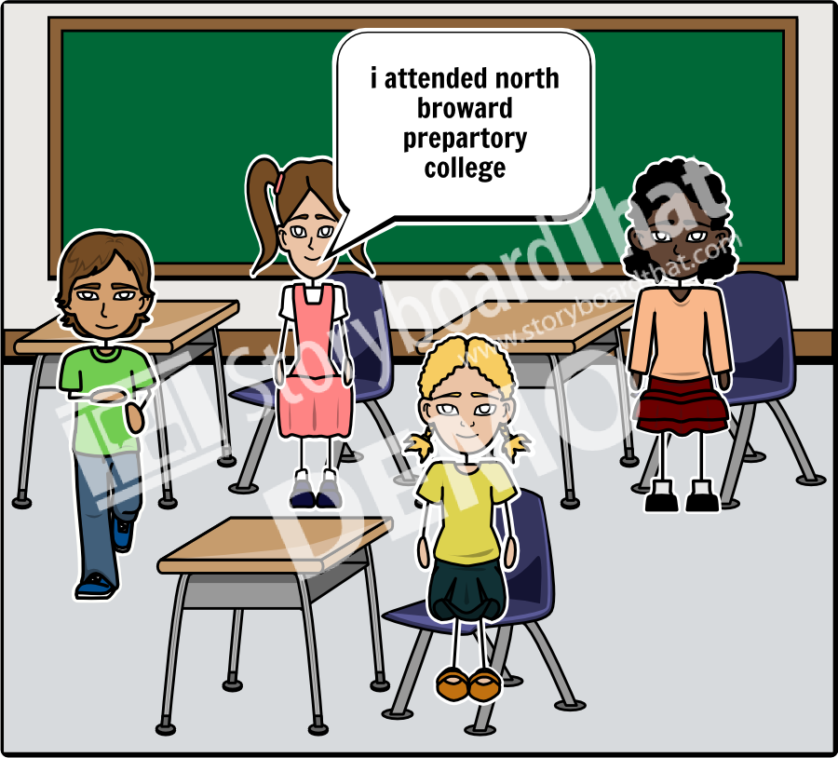
Add Title Here
what college did you attend?

Slide 4
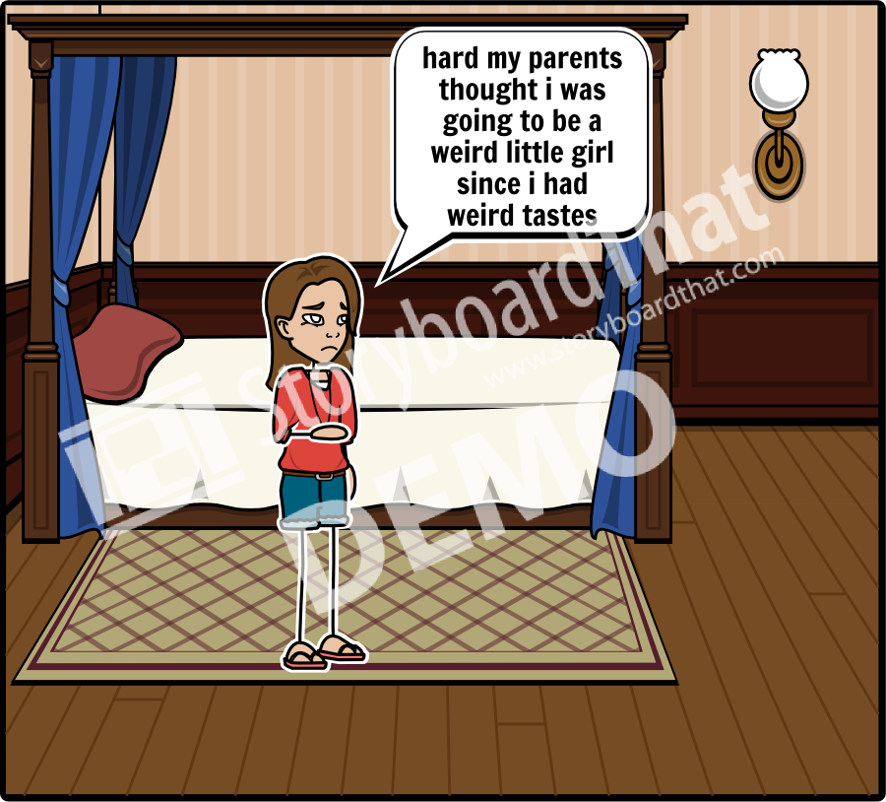
Add Title Here
how was your life growing up

Slide 5
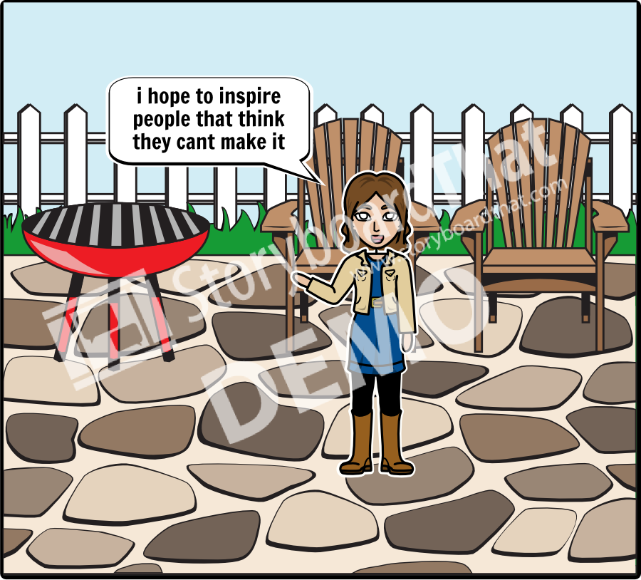
Add Title Here
do you hope to inspire young artist

Slide 6
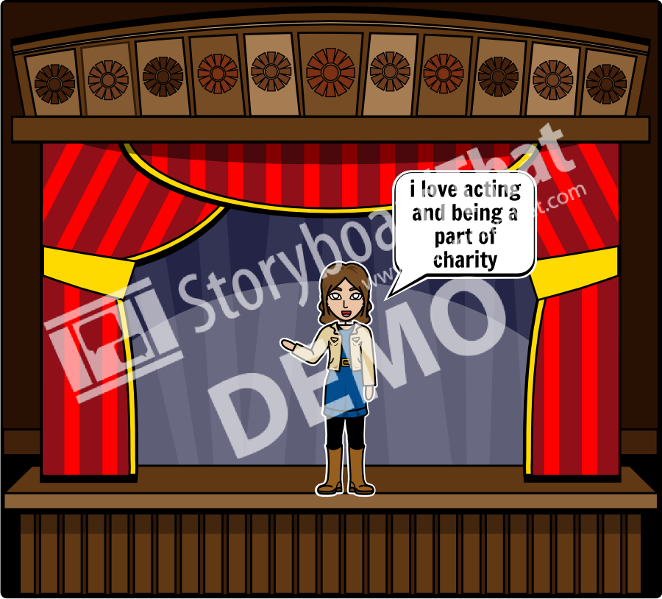
Add Title Here
do you have other talents other than singing

Slide 7
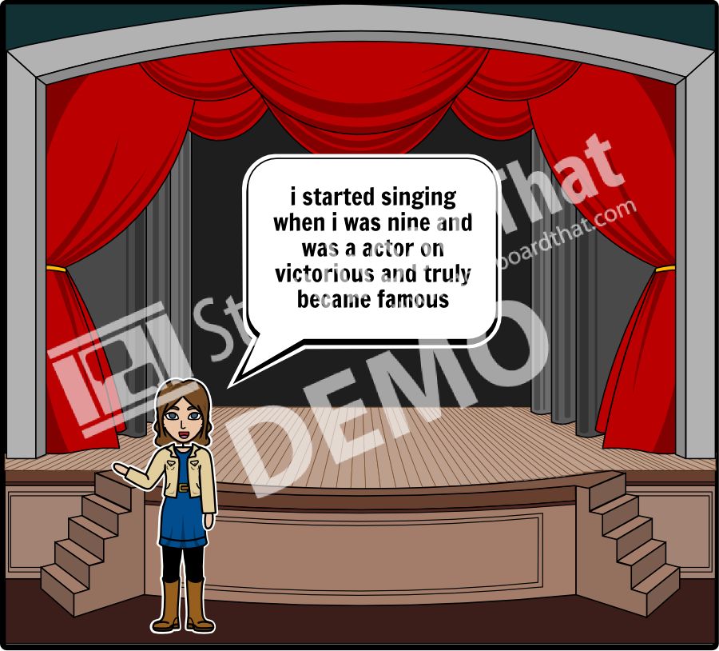
Add Title Here
when did and how did you become famous

