Slide 1
City Design Project -Expectations IB & Grading -Demonstration Notes

Slide 2
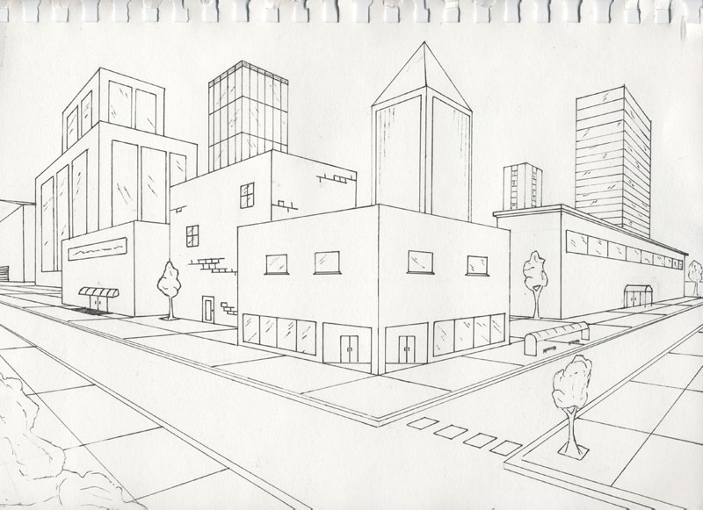
City Design Project 8th Grade
8th Grade will draw a city street corner with
two point perceptive.

Slide 3
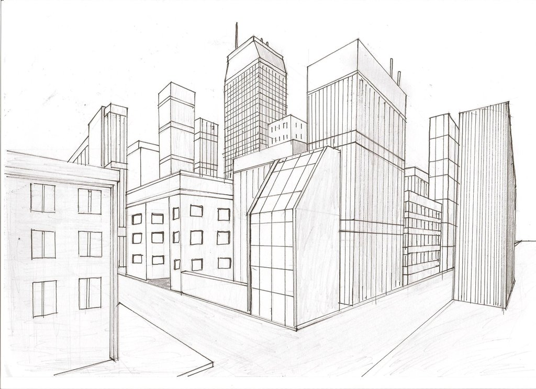

Slide 4
Vanishing Point: the point at which receding parallel lines viewed in perspective appear to converge:

Slide 5
City Design 8th Grade:
Expectations:
Use a ruler to draw all lines.
No shading.
Fill the paper with your design(s), don’t leave empty space.
Every horizontal line must lead to one of the vanishing points.
Make sure your work is neat, clean and creative.

Slide 6
IB Handout:

Slide 7
Objectives
By creating a city design through the correct perspective, we can communicate the right scale of buildings and designs.

Slide 8
City Design Project 7th Grade:
7th Graders will draw a city from a birds eye view from above.

Slide 9
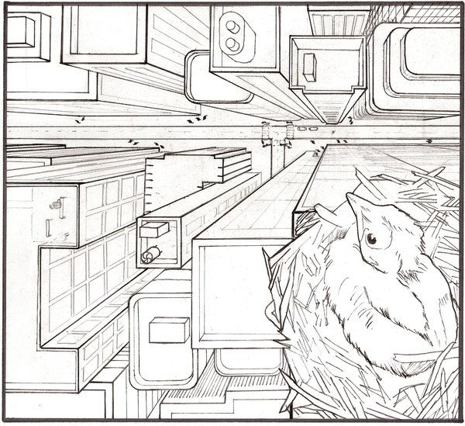

Slide 10
Demonstration:
Follow along in your drawing notes, on the worksheet provided.

Slide 11
City Design 7th Grade:
Expectations:
1) Use a ruler to draw all lines.
2) No shading.
3) Fill the paper with your design, don’t leave empty space.
4) Every building sideline must lead to the vanishing points.
5) Make sure your work is neat, clean and creative.

