Slide 1
Ceaser chavez

Slide 2
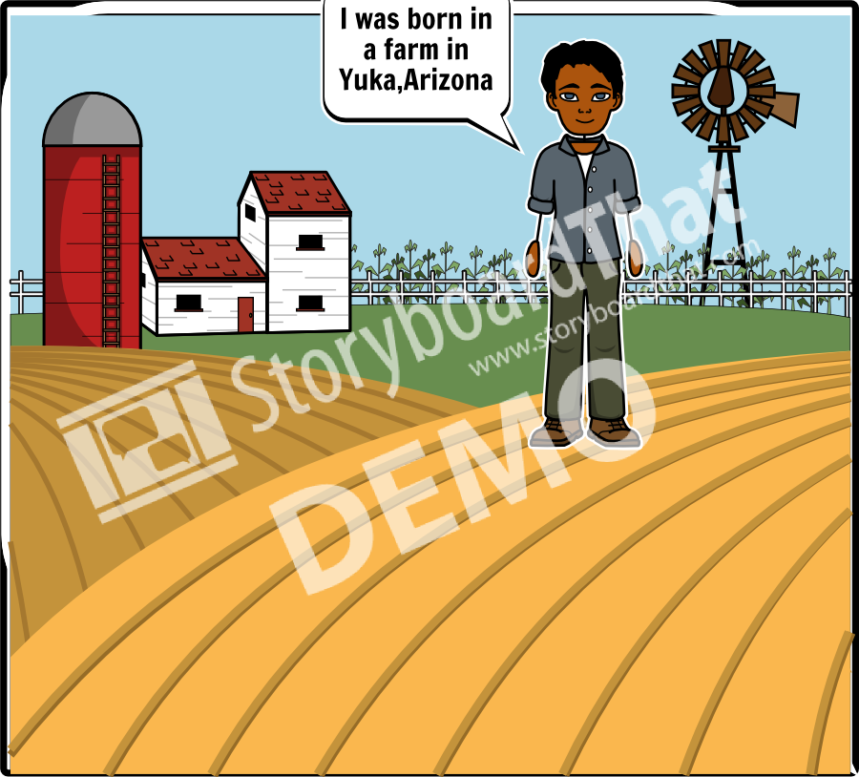
Add Title Here
Where were you raised?

Slide 3
Add Title Here
What insipred you to help the field workers?

Slide 4
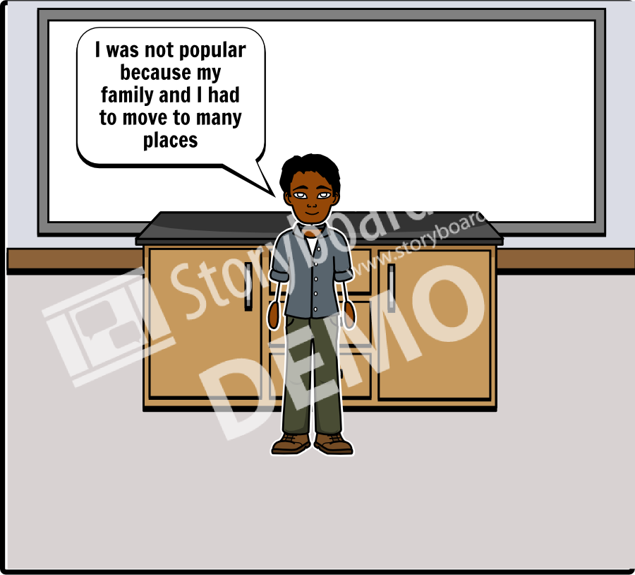
Add Title Here
Were you popular in school?

Slide 5
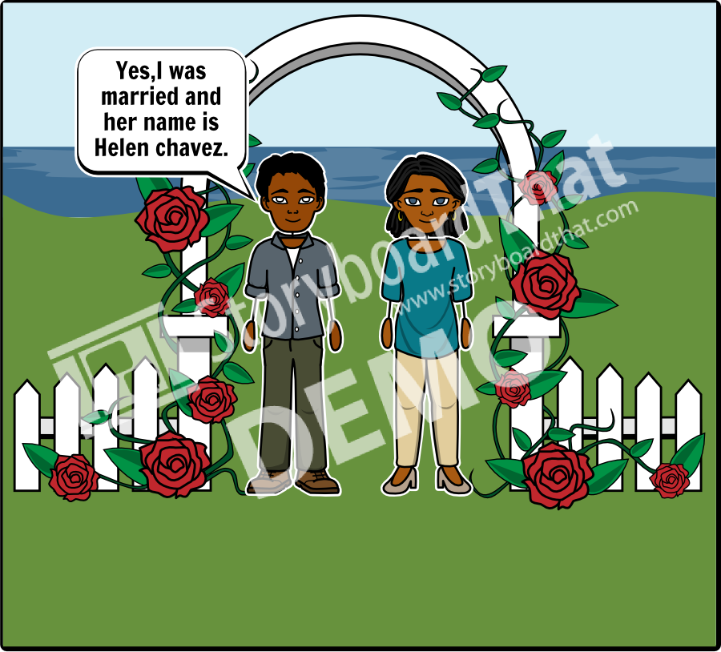
Add Title Here
Were you married?

Slide 6
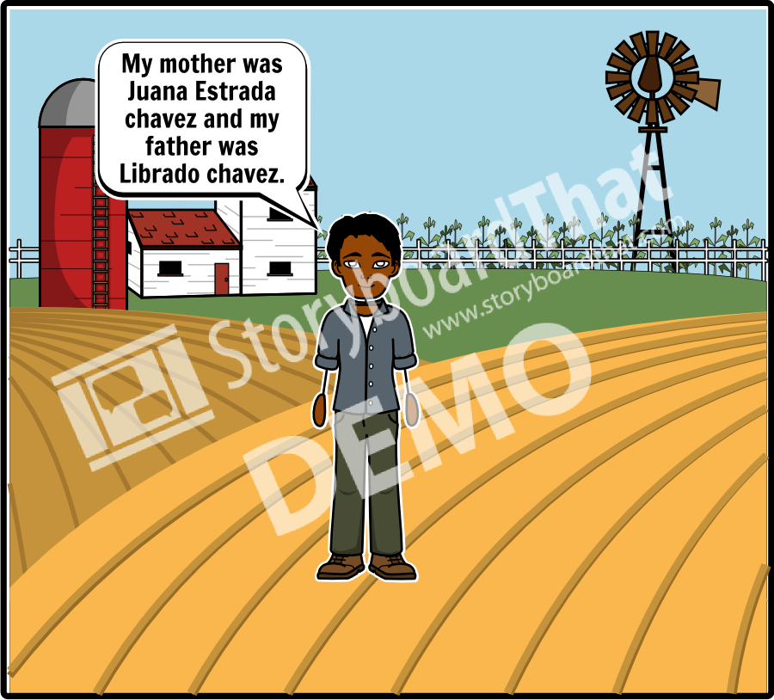
Add Title Here
Who were your parents?

Slide 7
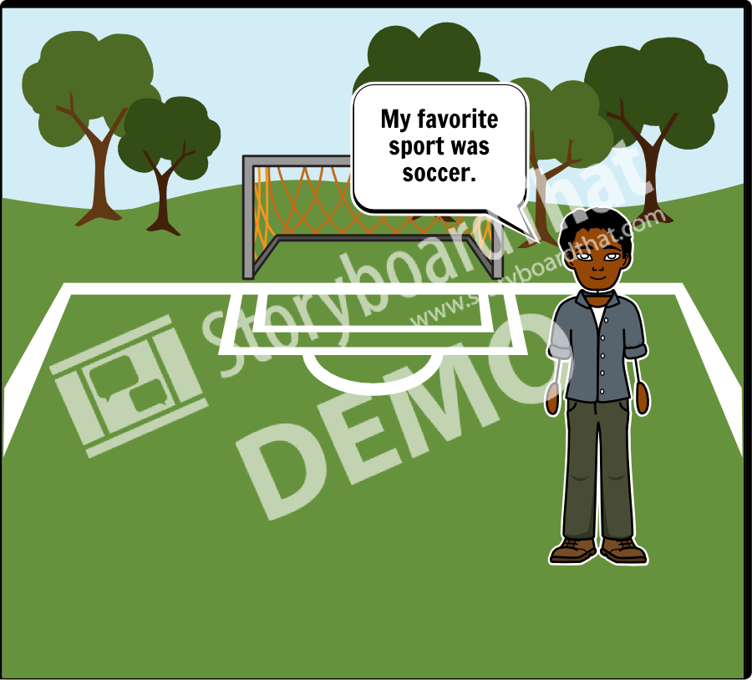
Add Title Here
What was your favorite sport?

